Slide 1
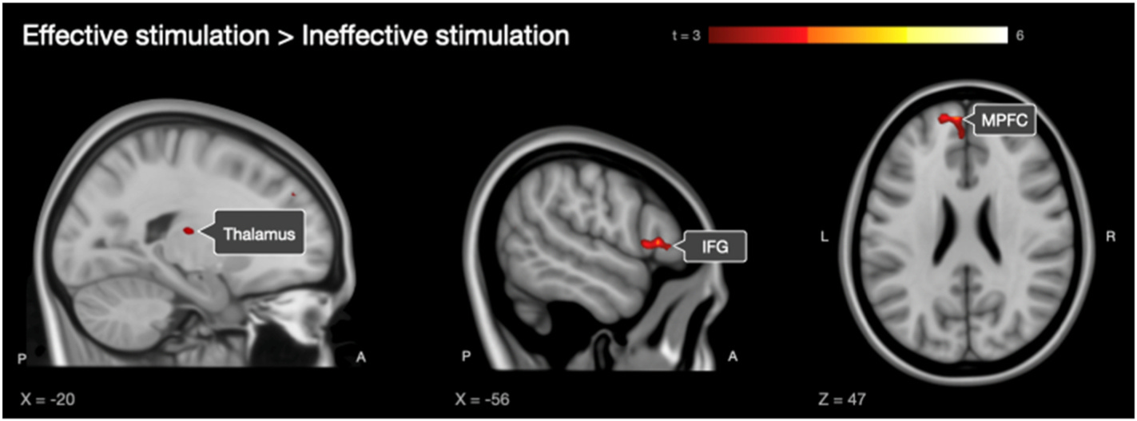
TIK GROUP / CHRONOMETRIC TMS-fMRI
Speech-network responses depend on TMS timing
Left STG stimulation during object naming · 5 pulses at 10 Hz · onset at 0 or 200 ms
Later TMS onset produced greater BOLD responses in IFG, medial PFC and thalamus.
Twenty healthy participants; speech responses were recorded in a separate session outside the scanner.
Vasileiadi M, Schuler A-L, Woletz M, Witz V, Grosshagauer S, Coetzee J, Tik M. Chronometric interleaved TMS-fMRI shows
state-dependent network effects underlying speech production. Brain Stimulation. 2026;19(1):103010. doi:10.1016/j.brs.2025.103010
Figure 9 reproduced unchanged · cluster-level FWE p < .05 · © 2025 The Authors · CC BY-NC-ND 4.0
Notes:
Source: https://doi.org/10.1016/j.brs.2025.103010
Vasileiadi et al., Brain Stimulation 2026;19(1):103010; published online 18 December 2025.
Figure 9 reproduced unchanged under CC BY-NC-ND 4.0: https://creativecommons.org/licenses/by-nc-nd/4.0/
Original figure: https://www.tmsfmri.com/wp-content/uploads/2026/09/vasileiadi-2026-timing-network-effects-figure-9.jpg
The 0 and 200 ms conditions refer to onset of five-pulse, 10 Hz bursts lasting 400 ms, not to isolated pulses or fMRI temporal resolution. Speech behavior was measured outside the scanner in a separate experiment; the fMRI experiment did not include concurrent speech recording. The findings support a state-dependent network account of TMS effects, not clinical validation of presurgical mapping.
Study page: https://www.tmsfmri.com/publicationlist/chronometric-tms-fmri-speech-production/

